Slide 1

The Work From Home Job Market
Matthew Boccio

Slide 2
Inspiration for the Project
Family
Covid-19
Technology

Slide 3
Questions to Answer
- What companies are posting these types of jobs?
- What kinds of jobs are they? Are they mostly full time, or part time? Salary, or commission?
- Are these kinds of jobs mostly entry level, or a mix of different seniority levels?
- What kind of education do you need for these jobs?
- Do these kinds of jobs pay well, when compared to nationwide and statewide median salary levels?
- Do you need to live close to the company, or is this a true remote opportunity where you can live anywhere in the US?

Slide 4
Methods
Scraped from Indeed.com, Filter = “Remote”
1000+ job postings from all across the United States
All posted between 5/7/2020 and 5/9/2020

Slide 5
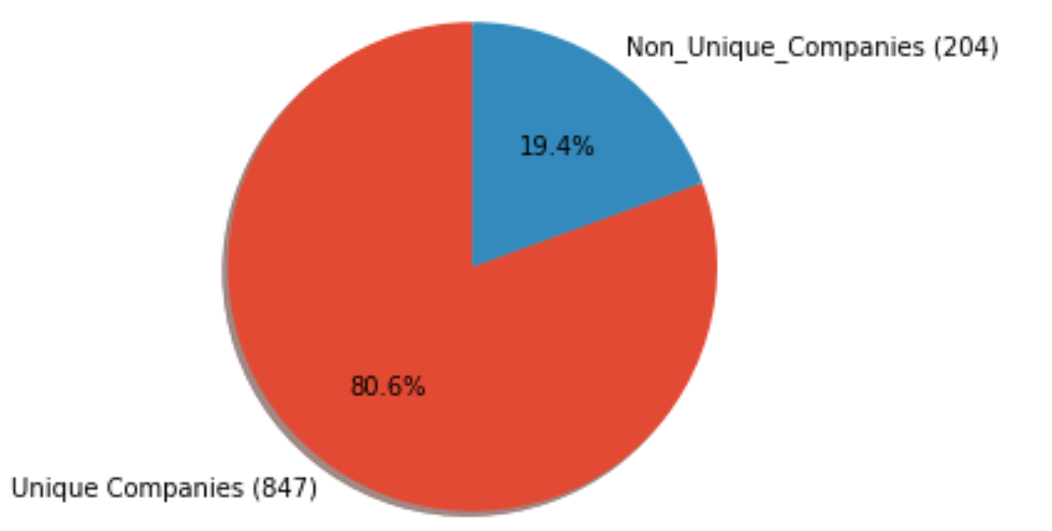
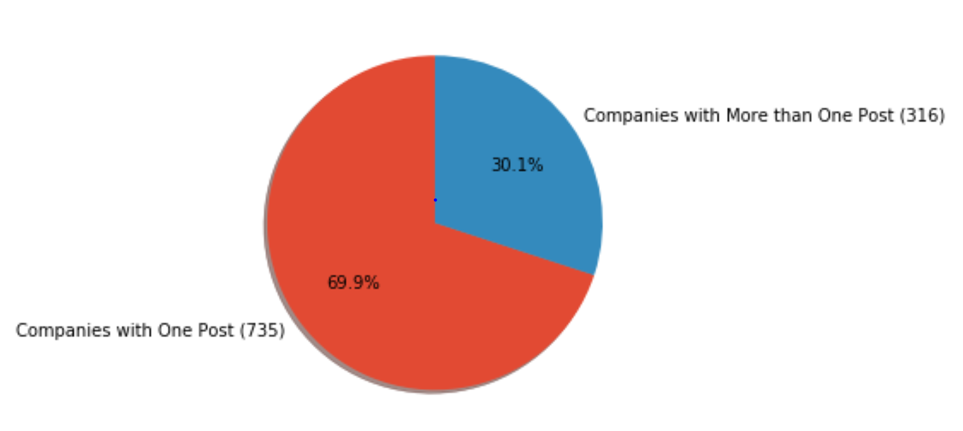
Findings
- No company had a monopoly on posts – over those two days, an enormous variety of businesses posted ads looking for remote workers

Slide 6
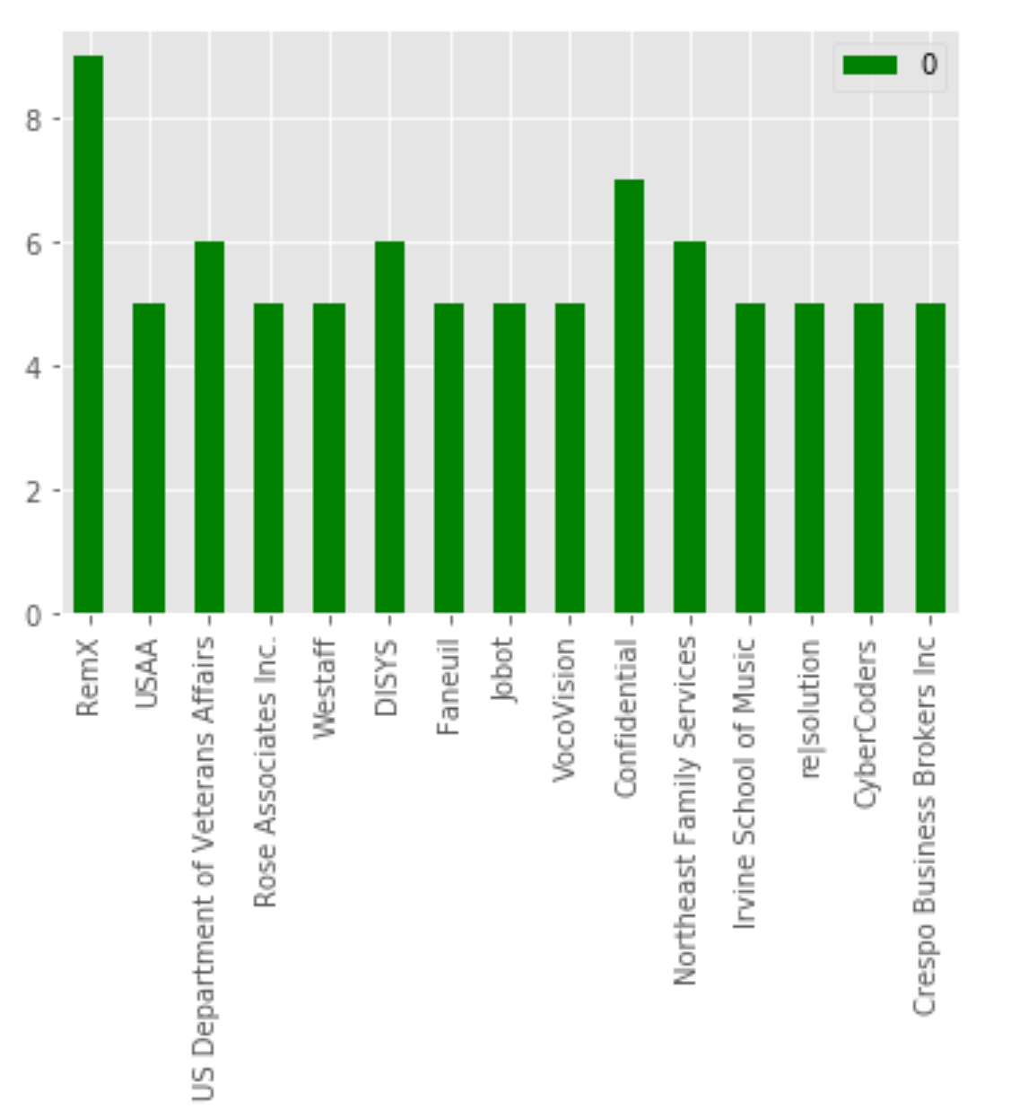
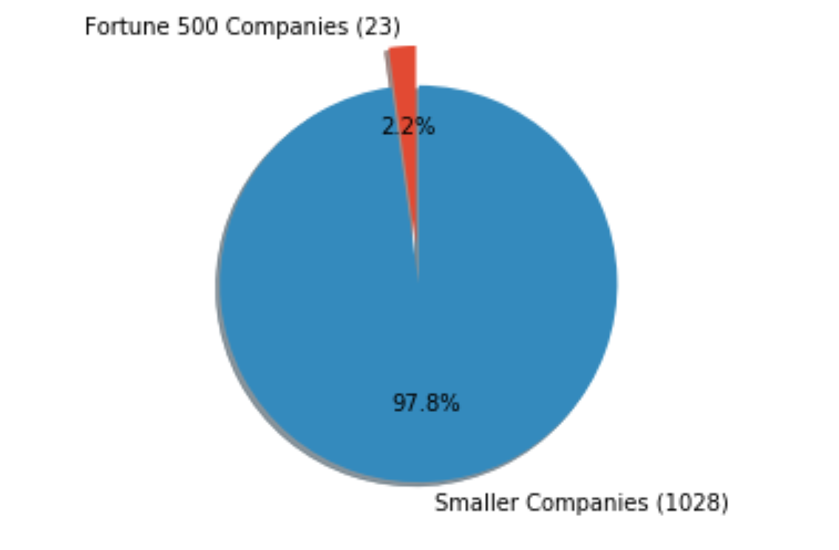
Findings
- The percentage of Fortune 500 companies posting ads was noticeably low. Smaller companies were posting the majority.

Slide 7
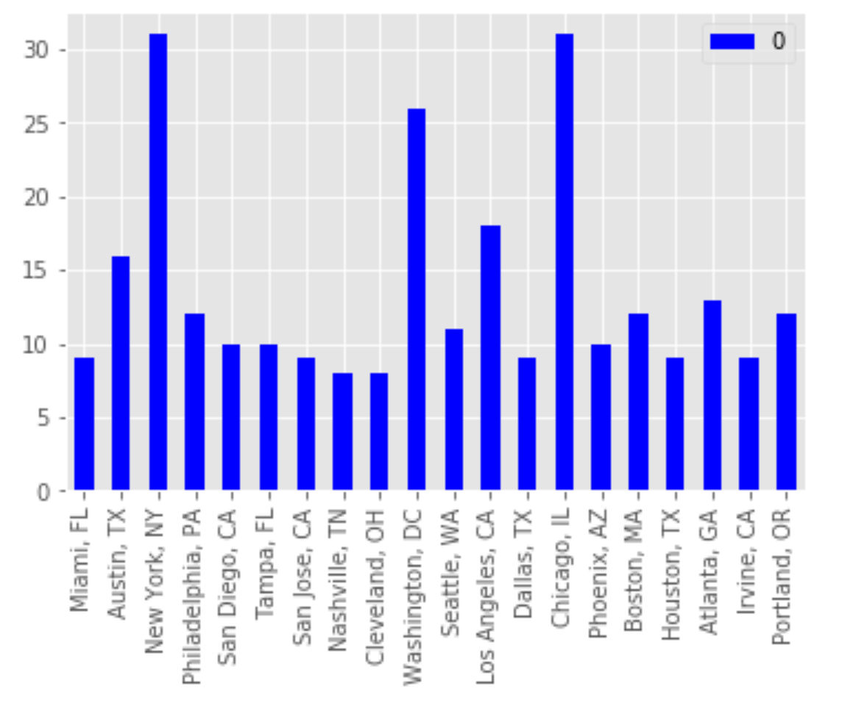
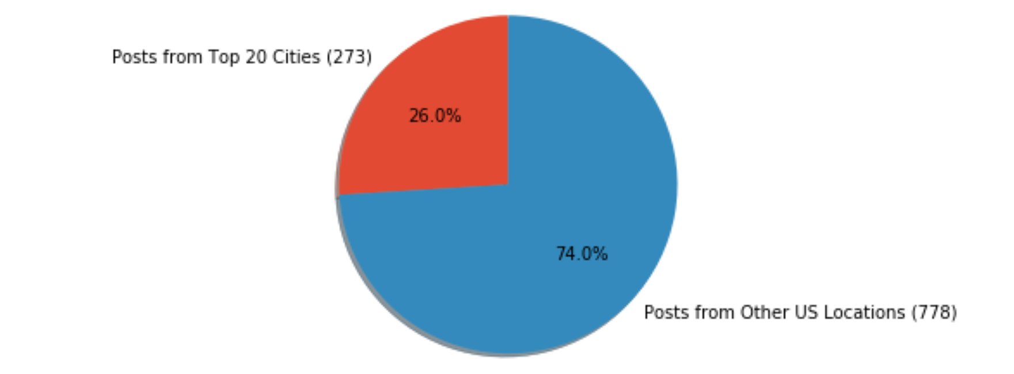
Findings
Posts from major hiring cities took up about a quarter of total posts, but hiring is being done all over the country

Slide 8
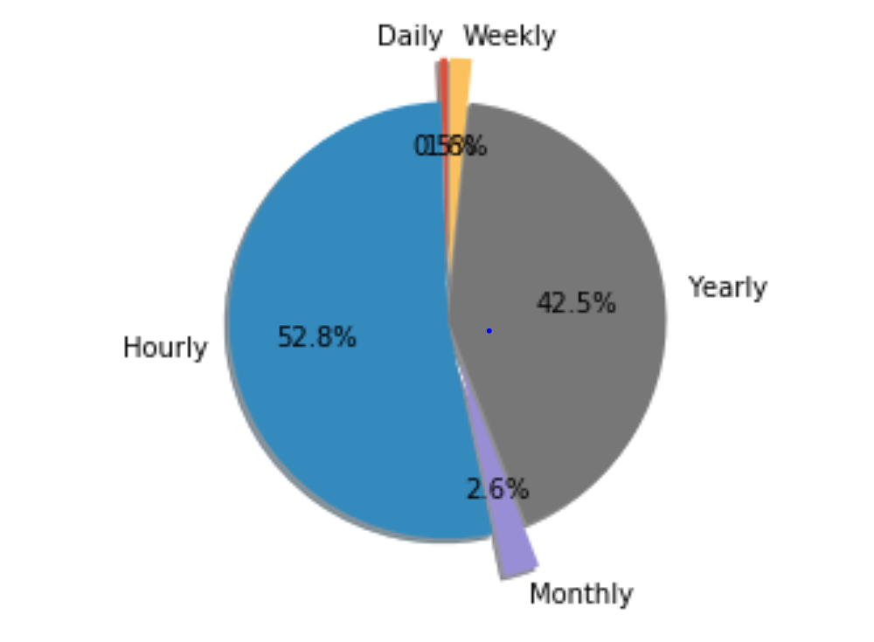
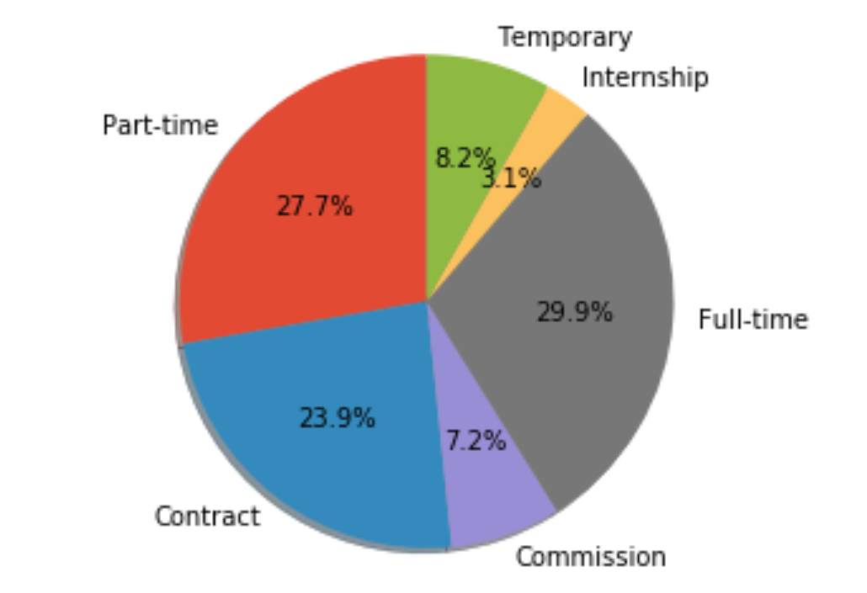
Findings
Most jobs either pay hourly, or are salaried positions. The skew towards hourly likely has to do with the types of jobs being posted

Slide 9
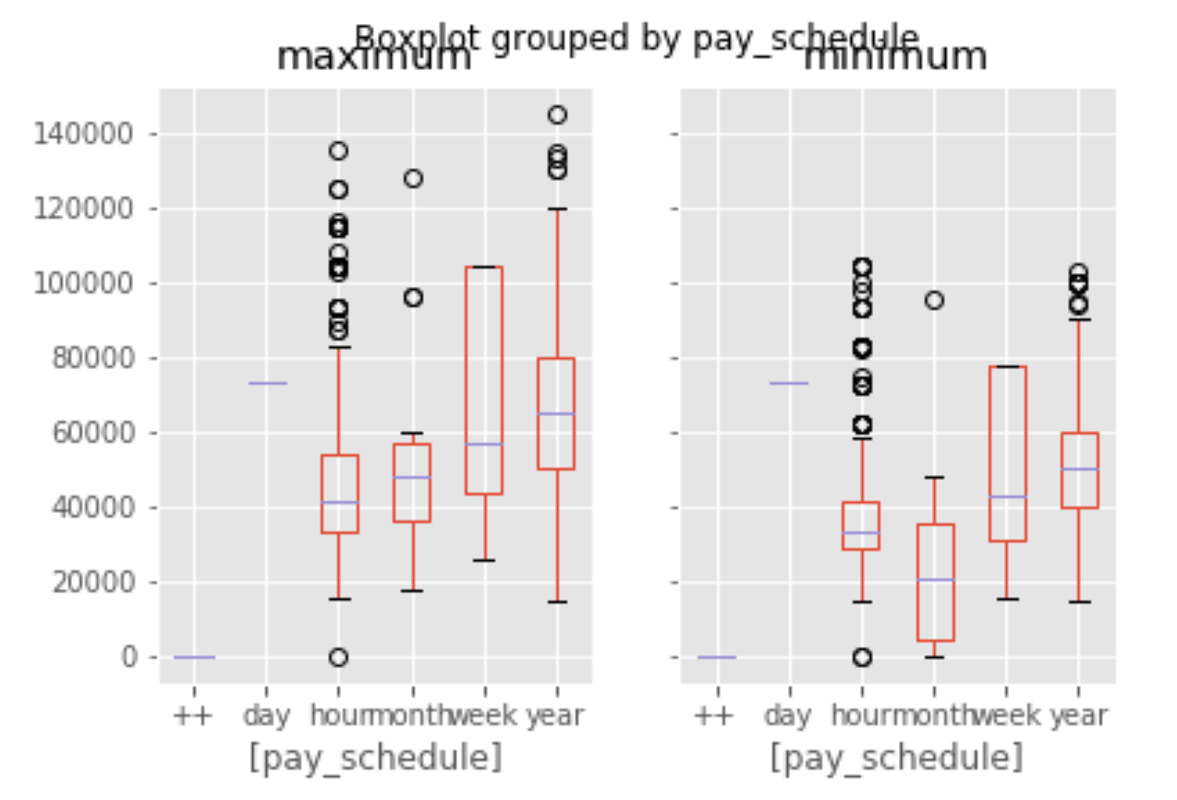
Findings
The range in hourly positions is massive – likely due to demand for specialized contract work.
Median maximum pay for remote jobs ranges between ~$40,000/yr for hourly work, up to ~$70,000/yr for salaried positions

Slide 10
To Further My Research
Average Experience Level Required
Average Education Level Required
Larger Data Set
Need to live local to work remote?

Slide 11
Conclusions
Decent money to be made, compared to median US salary*
Not many options for blue chip companies
Extraordinary Flexibility on Time Committment
*Source: https://www.cnbc.com/2017/08/24/how-much-americans-earn-at-every-age.html

Slide 12
THANK YOU

